Slide 1

P4 Language Tutorial
Slides: https://bit.ly/p4d2-2018-spring
Software Setup
Download VM or copy from USB stick
Import VM into VirtualBox or VMware Fusion
Boot VM and login as user "p4" with passwd "p4"
Open Terminal
cd ~/tutorials; git pull

Slide 2
Goals
Learn P4 Language
Traditional applications
Novel applications
Learn P4 software tools
P4 Compiler
BMv2
P4Runtime
Learn about future technology trends
Keynote by Arvind Krishnamurthy (Washington)
Panel with representatives from ONF, Kaloom, and Keysight
Networking (the other kind)
Have fun!

Slide 3
Introduction to Data Plane Programming
Language Basics
Break
Software Tools & P4 Runtime
Lunch
Keynote (Arvind Krishnamurthy)
Monitoring & Debugging
Break
Advanced Data Structures
Panel Discussion
Reception

Slide 4



Instructors
Stephen Ibanez
Stanford
Brian O'Connor
ONF
Mina Arashloo
Princeton

Slide 5

Thank you
Sedef Ozcana (P4.org)
Rachel Everman (Barefoot)
Arvind Krishnamurthy (Washington)
Panelists
Uyen Chau (ONF)
Bochra Boughzala (Kaloom)
Ben Pfaff (VMware)
Chris Sommers (Keysight)
TAs
Santiago Bautista (ENS/Cornell)
Sean Choi (Stanford)
Theo Jepsen (Lugano)
Sarah Tollman (Stanford)

Slide 6


Slide 7
What is Data Plane Programming?
Why program the Data Plane?

Slide 8
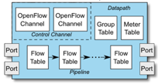
Software Defined Networking (SDN)
Main contributions
OpenFlow = standardized protocol to interact with switch
download flow table entries, query statistics, etc.
OpenFlow = standardized model
match/action abstraction
Concept of logically centralized control via a single entity (“SDN controller”)
Simplifies control plane
Issues
Data-plane protocol evolution requires changes to standards (12 → 40 OpenFlow match fields)
Limited interoperability between vendors (OpenFlow / netconf / JSON / XML variants)
Limited programmability
Control Function (“App”)
x m
Northbound I/F
SDN Controller
x 1
Southbound I/F
x n
Switch
Notes:
P4 and this whole programmable data-plane movement is really a logical extension to what many of you probably think of as software defined networking.
And I think its fair to say that SDN has really changed the way we operate big networks, for the better
OpenFlow is of course a key protocol that enables SDN, and it standardized a way to interact with the switch. So how to add/remove table entries, query statistics, and so forth. This protocol is what gives us runtime control over the network devices.
OpenFlow also standardized the model that we can use to program network devices, that is, it identified the match/action abstraction.
SDN also brought about the concept of logically centralized control of our network. And this is convenient because it can really help simplify the control-plane since we no longer have to wait for distributed algorithms to converge and we can have one central view of our network.
However, this approach to SDN was running into some issues.
One issue was that as data plane protocols changed and evolved, it required us to update the standards that we use for that southbound interface between the controller and the switch.
If you take a look at OpenFlow, the first version supported 12 header fields that you can match on, and now there are 40. So OpenFlow has already expanded quite a lot and will continue to do so as data-plane protocols continue to change and new ones are created. And as we all know, that process of making changes to a standard can take quite a long time. But what takes even longer is that you know have to update your switching chip ASIC to support the new data-plane protocol.
Another issue with this approach is the limited interoperability between vendors that provide SDN enabled switch chips. Some speak OpenFlow, others speak netconf, while others might speak some other SDN protocol. And these differences in the southbound interface must be handled at the SDN controller, which can be quite cumbersome.
Additionally, this approach provides limited programmability. When you buy an SDN enabled switch, it will support some fixed set of fields you can match on and some fixed set of actions that can be performed upon meeting the match criteria, but you can’t fundamentally change that set of match fields or that set of actions.
So these are exactly the issues that P4 and P4Runtime attempt to address.
So the way to think about it is that OpenFlow and this traditional SDN model are really designed to give those who own and operate big networks, control over the control-plane. P4 is now meant to give network operators control over the data-plane.

Slide 9
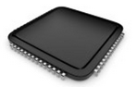
Status Quo: Bottom-up design
Switch OS
Network Demands
?
Run-time API
Driver
“This is how I know to
process packets”
(i.e. the ASIC datasheet
makes the rules)
Fixed-function ASIC
Notes:
To motivate this a bit more, let me describe how network systems are currently built
When you start building a network system you first define your list of requirements and the features you want to include
You then look at all of the different available packet-processing chips out there, which all have a datasheet that explains roughly in English how they process packets
You try to pick the one that best suits your needs, of course it also probably has a bunch of stuff you don’t need
But once you decide on a chip, that defines bottoms-up how your system will be built. It defines how the driver is written as well as how the control-plane running in the switch OS is able to interact with the forwarding plane in the fixed-function chip
Now of course, if you want to add a new feature, for example support a new protocol in your system, you need to change the fixed-function chip, which could take 4 years in the best case! And then after 4 years you’ve probably already figured out a hack to get around it, or if you do decide that still want it then you have to replace all of your hardware which is very expensive and can be big pain.
Now what P4 and this whole programmable data-plane movement are trying to do is turn this design philosophy upside down.

Slide 10

A Better Approach: Top-down design
Switch OS
Network Demands
Feedback
Run-time API
Driver
P4
“This is how I want the network to behave and how to switch packets…”
(the user / controller
makes the rules)
P4 Programmable Device
Notes:
What we really want is to be able to define at a high level exactly how the chip should process packets, which is done by writing a P4 program
That P4 program is then compiled down to the chip
This way network system designers get to define exactly what features they want to have in their system, without having to rely on third party chip vendors to make the decisions for them

Slide 11
Benefits of Data Plane Programmability
New Features – Add new protocols
Reduce complexity – Remove unused protocols
Efficient use of resources – flexible use of tables
Greater visibility – New diagnostic techniques, telemetry, etc.
SW style development – rapid design cycle, fast innovation, fix data plane bugs in the field
You keep your own ideas
Think programming rather than protocols…
Notes:
So why is P4 so great?
Of course, an obvious benefit is that new features can now be added very easily, simply change the P4 program and recompile. Or you may actually want to remove features that you are not using in order to reduce complexity in your network. Many network failures are caused by unanticipated interactions of features that network operators didn’t even know they were using!
With P4, it becomes very easy to reallocate resources between different tables after deployment. For fixed function switches, features and table sizes are baked in at design time.
With programmable forwarding also comes much greater visibility into the network, as well as a software style development process
And now that you can change the functionality of your network data plane without having to ask a third party chip vendor; you get to keep your own ideas allowing you to obtain a competitive advantage

Slide 12
Programmable Network Devices
PISA: Flexible Match+Action ASICs
Intel Flexpipe, Cisco Doppler, Cavium (Xpliant), Barefoot Tofino, …
NPU
EZchip, Netronome, …
CPU
Open Vswitch, eBPF, DPDK, VPP…
FPGA
Xilinx, Altera, …
These devices let us tell them how to process packets.
Notes:
One of the great things about P4 is that it can be compiled to many different network devices
The Barefoot Tofino is a flexible Match+Action based ASIC that is programmable by P4
Netronome has a P4 and C based framework for programing their SmartNIC
There are P4 compilers for software switches such as Open vSwitch and VPP
And Xilinx has a P4 compiler for FPGAs, which has already been integrated into the workflow for programming the NetFPGA platform

Slide 13
What can you do with P4?
Layer 4 Load Balancer – SilkRoad[1]
Low Latency Congestion Control – NDP[2]
In-band Network Telemetry – INT[3]
In-Network caching and coordination – NetCache[4] / NetChain[5]
Aggregation for MapReduce Applications [7]
… and much more
[1] Miao, Rui, et al. "SilkRoad: Making Stateful Layer-4 Load Balancing Fast and Cheap Using Switching ASICs." SIGCOMM, 2017.
[2] Handley, Mark, et al. "Re-architecting datacenter networks and stacks for low latency and high performance.” SIGCOMM, 2017.
[3] Kim, Changhoon, et al. "In-band network telemetry via programmable dataplanes.” SIGCOMM. 2015.
[4] Xin Jin et al. “NetCache: Balancing Key-Value Stores with Fast In-Network Caching.” To appear at SOSP 2017
[5] Jin, Xin, et al. "NetChain: Scale-Free Sub-RTT Coordination." NSDI, 2018.
[6] Dang, Huynh Tu, et al. "NetPaxos: Consensus at network speed.” SIGCOMM, 2015.
[7] Sapio, Amedeo, et al. "In-Network Computation is a Dumb Idea Whose Time Has Come." Hot Topics in Networks. ACM, 2017.
Notes:
Now what can you do with P4?
There are already a lot of interesting applications. Many of which have been published in high profile conferences such as SIGCOMM
SilkRoad, which is a stateful layer 4 load balancer implemented in hardware using the primitives provided by P4
NDP, which is a low latency congestion control algorithm for data centers
You can also implement a fast in-network cache for key-value stores
Or new telemetry techniques that provide unprecedented visibility into your network
Or you can even implement Paxos in your network
The list goes on…

Slide 14
Brief History and Trivia
May 2013: Initial idea and the name “P4”
July 2014: First paper (SIGCOMM CCR)
Aug 2014: First P4₁₄ Draft Specification (v0.9.8)
Sep 2014: P4₁₄ Specification released (v1.0.0)
Jan 2015: P4₁₄ v1.0.1
Mar 2015: P4₁₄ v1.0.2
Nov 2016: P4₁₄ v1.0.3
May 2017: P4₁₄ v1.0.4
Apr 2016: P4₁₆ – first commits
Dec 2016: First P4₁₆ Draft Specification
May 2017: P4₁₆ Specification released
Notes:
The ideas, surrounding the programmability of high-speed data planes appeared around 2013 <click> and in that same year the language name, which stands for Programming Protocol Packet Processors(P4) was coined
The language took its shape in 2014 <click>, and that’s when the first paper was published
Later, in that same year, the more formal and detailed public spec was released <click> along with the behavioral model and the compiler for it.
Since then there were minor spec revisions and amendments, but the language is quite stable and is supported on a number of targets
The idea of P4_16 germinated for some time and in April 2016 the first versions of the draft spec and the new compiler were committed to Github. <click>
Since then the language and tools were in intensive development and the first public draft was released in 2016, in December.
As many of you are probably aware, as of May 2017 the P4_16 language specification has been released and the p4-spec Github repository became publicly available.
A couple of words about versioning. Once P4_16 started to take shape, the original P4 became P4_14. We took our clues from a number of programming languages, such as C, C++, Fortran and Algol before them, noticing that the language that tend to have more independent implementations often use the year, while the languages with one dominant implementation tend to use regular version that corresponds to the version of that implementation. For P4 The version naming is based on the year of the original inception and then it takes about a year to finalize the spec. We support two versions of spelling: one for the terminals and “normal” programming work and a fancy one for the printed publications. Obviously, if you are familiar with TEX, you know that the underscore is the subscript indicator, so it is critically important to use underscore and not dash between “P4” and “16” (or 14 for that matter)

Slide 15
P4_16 Data Plane Model
Notes:
We will start with the basic P4 building blocks

Slide 16
PISA: Protocol-Independent Switch Architecture
Programmer defines the tables and the exact processing algorithm
Programmer declares how the output packet will look on the wire
Programmer declares the headers that should be recognized and their order in the packet
Programmable Match-Action Pipeline
Programmable Parser
Programmable Deparser
Notes:
In order to design a programming language, it is very useful to settle on the abstract machine, that is suited for the algorithms we'd like to express.
P4 is based on the abstract model of a high-speed packet processing device, called PISA, which stands for Protocol-Independent Switch Architecture.
PISA incorporates four basic components:
First, it is a programmable parser, which determines, which packet headers will be recognized by the data plane program. It is modeled as a simple, deterministic state machine, that consumes packet data and identifiers headers. It transitions between states typically by looking at specific fields in the previously identified headers. For example: The first 14 bytes are an Ethernet header. Then, if you look at the Ethertype, you know that the next header is a VLAN tag, an IPv4 or IPv6 header, an MPLS label, etc. If a parser identified an IPv4 header, it can jump to the next state based on IP protocol and so on.
At the heart of the PISA architecture is a pipeline, consisting of a set of “Match-Action” stages. What they can do is to match some data against a table that contains some entries and execute a corresponding action. If you think about it, that’s pretty much all the networking devices do. For example, an L2 switch will use a Destination MAC address (and a VLAN) to perform a match in an L2 table and then execute an action, such as “send a packet to this egress port”. Similarly, L3 switching is also easily reduced to a sequence of matches, such as Destination IP address lookup will produce a NexthopID and a lookup on a Nexthop ID will produce actions, such as “send to port”, “change MAC address”, “decrement TTL”, etc. ACLs, MPLS switching, everything can be expressed this way. Even basic things like if() or switch() statements can also be reduced to the basic operation of match and Action.
At the end of the pipeline, there is a programmable deparser that performs (as its name says)the operation, which is a reverse of the parsing. It re-assembles the packets back (e.g., by serializing the headers) so that the packets can go back onto the wire, into the queueing/replication engine etc.

Slide 17
PISA in Action
Packet is parsed into individual headers (parsed representation)
Headers and intermediate results can be used for matching and actions
Headers can be modified, added or removed
Packet is deparsed (serialized)
Programmable Match-Action Pipeline
Programmable Parser
Programmable Deparser
Notes:
The way PISA operates is quite straightforward (both figuratively and literally).
First, a packet arrives at the parser, which splits it into the individual headers, according to the parser program.
Then the parsed headers are passed into the match-action pipeline that matches either the headers or the intermediate results against match-action tables and performs a variety of operations:
For example it can remove or add headers
It can freely move the data between the headers, the intermediate results and the device state (represented here as tables)
It can perform both simple arithmetic and more specialized operations
Last, the deparser serializes the remaining headers back into the packet byte-stream

Slide 18
P4₁₆ Language Elements
Parsers
State machine, bitfield extraction
Controls
Tables, Actions, control flow statements
Expressions
Basic operations and operators
Data Types
Bistrings, headers, structures, arrays
Architecture Description
Programmable blocks and their interfaces
Extern Libraries
Support for specialized components
Notes:
P4 programs are composed of various different components
Parsers and controls are the main programmable blocks that you describe in P4
Parsers are implemented as a state machine and their sole purpose is to extract header fields from the packet in some user-defined way
Controls are responsible for the main match-action processing. This is where you define and apply your tables and actions to manipulate packet headers and metadata
The implementation of these parsers and control blocks is provided by the P4 programmer; they are built using the various data types and expressions defined in the language
On the other hand, the orange boxes listed here are provided by the vendor of the P4 programmable target.
The architecture description specifies a particular configuration of programmable parsers, control blocks, and perhaps vendor specific blocks.
The vendor may also provide a library of what we call “Externs”. Externs provide some functionality that is not implemented in P4, but provide an interface such that can interact with or be invoked by P4 programs. The P4 developer can think of them as black boxes. Externs may be specific to a particular target, but different targets may in fact support externs that provide the same interface and functionality, which facilitates portability of P4 programs.
Let’s now look at the specific architecture that we will be using for this tutorial, the V1Model.

Slide 19
P4_16 Approach
Term | Explanation
P4 Target | An embodiment of a specific hardware implementation
P4 Architecture | Provides an interface to program a target via some set of P4-programmable components, externs, fixed components
Community-Developed
Vendor-supplied
P4₁₆
Language
Extern Libraries
Architecture Definition
P4₁₆ Core Library
Notes:
P4_16 makes the distinction between a target and an architecture.
A target is the embodiment of a specific hardware implementation
Whereas an architecture provides an interface to program a target via some set of P4 programmable components, externs, and fixed components. Externs provide some functionality that is implemented by the vendor and are “black-boxes” invoked within P4 programs.
A target can potentially support many different architectures
Basically, the community develops and standardizes the language itself and the core library of the specialized objects that must always be present. <click>
The vendors of the target devices provide the architecture definitions for their platforms and the libraries of externs that they support. <click>

Slide 20
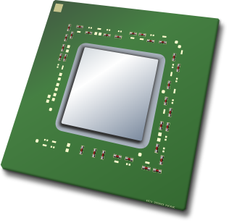
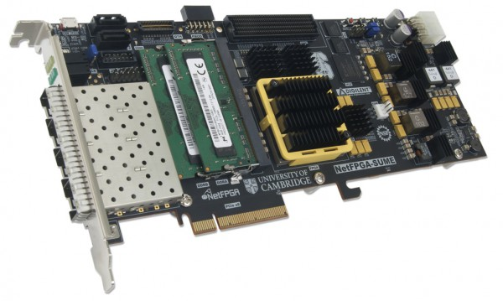
Example Architectures and Targets
V1Model
TM
SimpleSumeSwitch
TM
Portable Switch Architecture (PSA)
TM
Anything

Slide 21
Programming a P4 Target
User supplied
Control Plane
P4 Program
P4 Compiler
Add/remove table entries
Extern control
Packet-in/out
RUNTIME
CPU port
P4 Architecture
Model
Data Plane
Target-specific configuration binary
Tables
Extern
objects
Load
Target
Vendor supplied

Slide 22
Lab 1: Basics
Notes:
In this lab section, I will introduce the P4 language and walk you through a few basic example programs
By the end of the section you will know how to write your first P4 program as well as use the Bmv2 mininet environment to experiment with different designs

Slide 23
Before we start...
Install VM image (Look for instructor with USB sticks)
Please make sure that your VM is up to date
$ cd ~/tutorials && git pull
We’ll be using several software tools pre-installed on the VM
Bmv2: a P4 software switch
p4c: the reference P4 compiler
Mininet: a lightweight network emulation environment
Each directory contains a few scripts
$ make : compiles P4 program, execute on Bmv2 in Mininet, populate tables
*.py: send and receive test packets in Mininet
Exercises
Each example comes with an incomplete implementation; your job is to finish it!
Look for “TODOs” (or peek at the P4 code in solution/ if you must)
Notes:
Before we start, if you would like to follow along as I walk through the introductory examples, please download the VM image from the link that is provided in the description of the video. This VM has all of the necessary dependencies already installed to make it easy to get going.
These dependencies include: the Bmv2 software switch, the p4c reference P4 compiler, and Mininet setting up a network of our P4 switches.
If you already have these dependencies installed you may clone the tutorial source code from github as shown here

Slide 24
V1Model Architecture
Implemented on top of Bmv2’s simple_switch target
Parser
Checksum Verification / Ingress Match-Action
Checksum Update / Egress Match-Action
Deparser
Traffic
Manager
Notes:
The V1Model architecture is implemented on top of the Bmv2’s simple_switch target.
For those that don’t know, the Bmv2 simple_switch is a software switch developed by P4.org for testing the functionality of P4 programs. The V1Model is by no means the only architecture that can be supported by Bmv2, but it is the one that we will use today.
It consists of a P4 programmable parser and deparser, a block to verify checksums on incoming packets, a block to update checksums on outgoing packets, separate ingress and egress pipelines of match-action processing, as well as a traffic manager. The traffic manager is not currently programmable in P4 but performs the task of scheduling and sometimes replicating packets between the input and output ports.
The architecture description also includes a set of standard metadata fields that are used by the P4 program to direct the packet through the Bmv2 simple_switch.
label elements
**** Alternative ****
It consists of the following components:
A programmable parser to extract the packet headers in some P4 defined way
A programmable deparser at the end to reconstruct the packet as specified in the P4 program
Separate blocks to verify checksums on incoming packets and update checksums on outgoing packets
An ingress pipeline of match-action processing which is used to ...
An egress pipeline of match-action processing allowing the P4 program to modify a packet based on the port it is departing from
And a traffic manager which is not currently programmable in P4 but performs the task of scheduling and sometimes replicating packets between the input and output ports

Slide 25
V1Model Standard Metadata
struct standard_metadata_t {
bit<9> ingress_port;
bit<9> egress_spec;
bit<9> egress_port;
bit<32> clone_spec;
bit<32> instance_type;
bit<1> drop;
bit<16> recirculate_port;
bit<32> packet_length;
bit<32> enq_timestamp;
bit<19> enq_qdepth;
bit<32> deq_timedelta;
bit<19> deq_qdepth;
bit<48> ingress_global_timestamp;
bit<32> lf_field_list;
bit<16> mcast_grp;
bit<1> resubmit_flag;
bit<16> egress_rid;
bit<1> checksum_error;
}
ingress_port - the port on which the packet arrived
egress_spec - the port to which the packet should be sent to
egress_port - the port that the packet will be sent out of (read only in egress pipeline)
Notes:
Here on the left I am showing a list of the various standard metadata fields defined for the V1Model.
I’ll point out some of the most commonly used fields
The ingress_port is set by the simple_switch target and indicates the port on which the packet arrived
The egress_spec field should be set in the ingress pipeline to tell the traffic manager which port to send the packet to
The egress_port can be read within the egress pipeline, and indicates which port the packet is departing from
There are also many other fields here that can be used by P4 programs that target the V1Model

Slide 26
P4₁₆ Program Template (V1Model)
#include <core.p4>
#include <v1model.p4>
/* HEADERS */
struct metadata { ... }
struct headers {
ethernet_t ethernet;
ipv4_t ipv4;
}
/* PARSER */
parser MyParser(packet_in packet,
out headers hdr,
inout metadata meta,
inout standard_metadata_t smeta) {
...
}
/* CHECKSUM VERIFICATION */
control MyVerifyChecksum(in headers hdr,
inout metadata meta) {
...
}
/* INGRESS PROCESSING */
control MyIngress(inout headers hdr,
inout metadata meta,
inout standard_metadata_t std_meta) {
...
}
/* EGRESS PROCESSING */
control MyEgress(inout headers hdr,
inout metadata meta,
inout standard_metadata_t std_meta) {
...
}
/* CHECKSUM UPDATE */
control MyComputeChecksum(inout headers hdr,
inout metadata meta) {
...
}
/* DEPARSER */
control MyDeparser(inout headers hdr,
inout metadata meta) {
...
}
/* SWITCH */
V1Switch(
MyParser(),
MyVerifyChecksum(),
MyIngress(),
MyEgress(),
MyComputeChecksum(),
MyDeparser()
) main;
Notes:
Here is a template for a typical P4 program written for the V1Model
At the top of the file, we must include core.p4 because it defines some of the common types that are used in all P4 programs
<click> We also must include v1model.p4, which provides the definition of the V1Model architecture and also declares the various externs that can be used for this target; such as counters, meters, and registers
<click> A P4 program typically begins by declaring the format of various packet headers and building the headers and metadata structs. These structs are passed from block to block, along with the standard_metadata, as the packet traverses the architecture
Subsequently, the P4 source file (or files) must define the functionality for the parser
<click> checksum verification block
<click> ingress match-action processing
<click> egress match-action processing
<click> checksum update block
<click> deparser
<click> And finally, the P4 program must instantiate an instance of the architecture called main.
Let’s now take a look at the most basic example of a P4 program

Slide 27
P4₁₆ Hello World (V1Model)
#include <core.p4>
#include <v1model.p4>
struct metadata {}
struct headers {}
parser MyParser(packet_in packet,
out headers hdr,
inout metadata meta,
inout standard_metadata_t standard_metadata) {
state start { transition accept; }
}
control MyVerifyChecksum(inout headers hdr, inout metadata meta) { apply { } }
control MyIngress(inout headers hdr,
inout metadata meta,
inout standard_metadata_t standard_metadata) {
apply {
if (standard_metadata.ingress_port == 1) {
standard_metadata.egress_spec = 2;
} else if (standard_metadata.ingress_port == 2) {
standard_metadata.egress_spec = 1;
}
}
}
control MyEgress(inout headers hdr,
inout metadata meta,
inout standard_metadata_t standard_metadata) {
apply { }
}
control MyComputeChecksum(inout headers hdr, inout metadata meta) {
apply { }
}
control MyDeparser(packet_out packet, in headers hdr) {
apply { }
}
V1Switch(
MyParser(),
MyVerifyChecksum(),
MyIngress(),
MyEgress(),
MyComputeChecksum(),
MyDeparser()
) main;
Notes:
This is what I like to call the Hello World example for P4 programs. It is essentially just a wire that connects port 1 to port 2.
For this example, the parser does not need to extract any headers from the packet. It simple accepts and the packet is passed along to MyVerifyChecksum() block, which also does not need to do anything.
<click> When the packet reaches the MyIngress() block, the P4 program checks the port on which the packet arrived by reading the ingress_port field of the standard_metadata bus and decides which port to send the packet to using a simple if, else-if statement.
The rest of the blocks do not need to do anything and at the end of the program we instantiate the switch.
As you can see, all packets that arrives on port 1 will be sent to port 2 and all packets that arrive on port 2 will be sent to port 1
In this example, the connection between port 1 and port 2 is hardcoded and cannot be changed after the P4 program is compiled. Let’s see how we can make the switch a bit more flexible

Slide 28
P4₁₆ Hello World (V1Model)
#include <core.p4>
#include <v1model.p4>
struct metadata {}
struct headers {}
parser MyParser(packet_in packet, out headers hdr,
inout metadata meta,
inout standard_metadata_t standard_metadata) {
state start { transition accept; }
}
control MyIngress(inout headers hdr, inout metadata meta,
inout standard_metadata_t standard_metadata) {
action set_egress_spec(bit<9> port) {
standard_metadata.egress_spec = port;
}
table forward {
key = { standard_metadata.ingress_port: exact; }
actions = {
set_egress_spec;
NoAction;
}
size = 1024;
default_action = NoAction();
}
apply { forward.apply(); }
}
control MyEgress(inout headers hdr,
inout metadata meta,
inout standard_metadata_t standard_metadata) {
apply { }
}
control MyVerifyChecksum(inout headers hdr, inout metadata meta) { apply { } }
control MyComputeChecksum(inout headers hdr, inout metadata meta) { apply { } }
control MyDeparser(packet_out packet, in headers hdr) {
apply { }
}
V1Switch( MyParser(), MyVerifyChecksum(), MyIngress(), MyEgress(), MyComputeChecksum(), MyDeparser() ) main;
Key | Action ID | Action Data
1 | set_egress_spec ID | 2
2 | set_egress_spec ID | 1
Notes:
This design achieves the exact same functionality as what we just saw, but rather than using the if, else-if statement in the MyIngress control block, it uses a single table, called forward.
The forward table matches on the ingress_port field, and can invoke either the set_egress_spec action, or NoAction.
The table entries specify which action to take, along with any input parameters, for different ingress_port values.
We will explain P4 tables in more detail shortly.
By writing our P4 program in this way, we have created a much more flexible switch because now we can add and remove table entries from the control plane to determine how to to route packets between the various ports. And we can do this without changing the P4 program at all.

Slide 29
Running Example: Basic Forwarding
We’ll use a simple application as a running example—a basic router—to illustrate the main features of P4₁₆
Basic router functionality:
Parse Ethernet and IPv4 headers from packet
Find destination in IPv4 routing table
Update source / destination MAC addresses
Decrement time-to-live (TTL) field
Set the egress port
Deparse headers back into a packet
We’ve written some starter code for you (basic.p4) and implemented a static control plane
Notes:
For the rest of this tutorial, we will consider the design of a basic IP router and use this as our running example to introduce the main features of P4_16
Our simple IP router will perform the following functions:
Parse Ethernet and IPv4 headers from the packet
Find destination in IPv4 routing table
Update the source and destination MAC addresses
Decrement the TTL field
Set the egress port
Deparse the headers to construct the final packet
For those of you that would like to follow along, the starter code for this exercise is in a file called basic.p4 and we have already implemented a static control plane for you so we won’t worry about configuring the forwarding tables. Instead, we will focus our efforts on understanding the data plane description in P4.

Slide 30

Basic Forwarding: Topology
h1 (10.0.1.1)
h2 (10.0.2.2)
s1
s2
s3
h3 (10.0.3.3)
Notes:
Here is the basic topology that we have set up in Mininet. It consists of 3 switches connected in a triangle topology and 1 host attached to each switch.
The P4 program that we write will determine the functionality of each switch.
In this exercise, we will try to send IP packets from 10.0.1.1 to 10.0.2.2. In other words, from host 1 to host 2.

Slide 31
P4₁₆ Types (Basic and Header Types)
typedef bit<48> macAddr_t;
typedef bit<32> ip4Addr_t;
header ethernet_t {
macAddr_t r; dstAdd
macAddr_t srcAddr;
bit<16> etherType;
}
header ipv4_t {
bit<4> version;
bit<4> ihl;
bit<8> diffserv;
bit<16> totalLen;
bit<16> identification;
bit<3> flags;
bit<13> fragOffset;
bit<8> ttl;
bit<8> protocol;
bit<16> hdrChecksum;
ip4Addr_t srcAddr;
ip4Addr_t dstAddr;
}
Basic Types
bit<n>: Unsigned integer (bitstring) of size n
bit is the same as bit<1>
int<n>: Signed integer of size n (>=2)
varbit<n>: Variable-length bitstring
Header Types: Ordered collection of members
Can contain bit<n>, int<n>, and varbit<n>
Byte-aligned
Can be valid or invalid
Provides several operations to test and set validity bit: isValid(), setValid(), and setInvalid()
Typedef: Alternative name for a type
Notes:
Before we dive into P4 programming, let me first point out some of the basic types that can be used in P4 programs.
An unsigned integer is called a “bitstring” in P4 and this type can have an arbitrary width. You can perform many different operations on bitstrings such as addition, subtraction, and concatenation. You can also slice bitstrings similar to how you might slice a python string or a verilog bus.
Signed integers are simply called ints in P4 and they support some, but not all, of the same basic operations as bitstrings.
P4 also supports the notion of a variable sized bitstring for protocols that contain fields whose width is only known at runtime. For example, IPv4 options. In this case, n is the maximum possible width of the bitstring.
Please refer to the P4_16 specification for a list of all possible operations that are supported for these types.
A header is an ordered collection of members each of which may be one of the types we just discussed.
Headers are byte-aligned and they can be either valid or invalid. P4 programs can read and write a header’s validity bit using the isValid(), setValid(), and setInvalid() methods
On the left we show how you might declare an Ethernet and IPv4 header in P4. Also note that the typedef statement can used to make your code more readable.

Slide 32
P4₁₆ Types (Other Types)
/* Architecture */
struct standard_metadata_t {
bit<9> ingress_port;
bit<9> egress_spec;
bit<9> egress_port;
bit<32> clone_spec;
bit<32> instance_type;
bit<1> drop;
bit<16> recirculate_port;
bit<32> packet_length;
...
}
/* User program */
struct metadata {
...
}
struct headers {
ethernet_t ethernet;
ipv4_t ipv4;
}
Other useful types
Struct: Unordered collection of members (with no alignment restrictions)
Header Stack: array of headers
Header Union: one of several headers
Notes:
The struct is another useful type. It consists of an unordered collection of members and has no alignment restrictions.
We have already seen an example use case of a struct when we showed the standard_metadata for the V1Model.
P4 programs often combine a collection of headers into a struct and then use that struct within each programmable block
Multiple headers of the same type can also be combined into a header stack, which is essentially treated as an array of headers
A header union represents an alternative containing at most one of several different headers. For example, you might want to declare a header union consisting of an IPv4 header and a IPv6 header if you expect all packets to contain only one of these and never both.

Slide 33
P4₁₆ Parsers
Parsers are functions that map packets into headers and metadata, written in a state machine style
Every parser has three predefined states
start
accept
reject
Other states may be defined by the programmer
In each state, execute zero or more statements, and then transition to another state (loops are OK)
start
accept
reject
Notes:
Now let’s take a look at how to write parsers in P4.
Parsers are functions that map packets into headers and metadata.
They are written as a state machine that contain 3 predefined states: start, accept, and reject
It may also contain other states defined by the P4 programmer.
It is common to define one state for each header type that the parser will extract, but this is not required.
Parsing always starts in the start state, executes zero or more statements, and then transitions to another state until it encounters either the accept or reject state. It is up to the architecture to decide what should happen upon reaching the reject state. For the V1Model, the packet is not dropped …
Loops are acceptable within the parsing state machine.

Slide 34
Parsers (V1Model)
/* From core.p4 */
extern packet_in {
void extract<T>(out T hdr);
void extract<T>(out T variableSizeHeader,
in bit<32> variableFieldSizeInBits);
T lookahead<T>();
void advance(in bit<32> sizeInBits);
bit<32> length();
}
/* User Program */
parser MyParser(packet_in packet,
out headers hdr,
inout metadata meta,
inout standard_metadata_t std_meta) {
state start {
packet.extract(hdr.ethernet);
transition accept;
}
}
MyParser
packet_in
hdr
meta
meta
The platform Initializes User Metadata to 0
standard_meta
Notes:
As shown on the right, the parser in the V1Model accepts the input packet and must produce the parsed header representation.
The user metadata and standard metadata buses also pass through the parser and can be used if desired.
On the left at the top, we are showing the definition of the packet_in type from core.p4. This type has various methods that are very useful when writing the parser.
For this tutorial, we will only use the most basic extract method, which allows you to extract a fixed size header from the packet. See the language specification for more details on the other more advanced parsing methods.
At the bottom is an example of a very simple parser that only defines the functionality of the start state. It simply extracts the ethernet header from the packet and then transitions to the accept state.

Slide 35
Select Statement
state start {
transition parse_ethernet;
}
state parse_ethernet {
packet.extract(hdr.ethernet);
transition select(hdr.ethernet.etherType) {
0x800: parse_ipv4;
default: accept;
}
}
P4₁₆ has a select statement that can be used to branch in a parser
Similar to case statements in C or Java, but without “fall-through behavior”—i.e., break statements are not needed
In parsers it is often necessary to branch based on some of the bits just parsed
For example, etherType determines the format of the rest of the packet
Match patterns can either be literals or simple computations such as masks
Notes:
To design parsers with more states we will often want to use the select statement.
The structure is very similar to a case statement in C or Java, but without the “fall-through behavior” meaning that we don’t need to use break statements
Parsers commonly want to branch based on some of the bits that were just parsed.
For example, here on the left we show a parser that extracts the ethernet header and then branches to either the parse_ipv4 state or the accept state based on the ethernet’s etherType field.
The match patterns can either be literals or simple computations such as masks

Slide 36
Coding Break
Notes:
Now let’s try to write the parser for our basic IPv4 router.
We will go over to our VM, enter into the basic exercise directory and open up the basic.p4 file.
This file follows the same basic structure as the Hello World example that we saw earlier.
The Ethernet and IPv4 headers have already been defined and added into the headers struct, but the parser block is empty so we must fill this in.
Let’s begin by defining the states we want to use.
Parsers must always start in the start state.
Then we will define a state for the ethernet header as well as a state for the IPv4 header.
Packets will always begin with the Ethernet header so let’s transition to the parse_ethernet state from the start state.
In this state, we will first extract the ethernet header and then we can branch based on the etherType field using the select statement that we saw earlier.
If the etherType field is equal to the IPV4_TYPE defined above, then we transition to the parse_ipv4 state, otherwise the packet does not contain an IPv4 header so we are done
In the parse_IPv4 state we simply need to extract the IPv4 header and then we are done.

Slide 37
P4₁₆ Controls
Similar to C functions (without loops)
Can declare variables, create tables, instantiate externs, etc.
Functionality specified by code in apply statement
Represent all kinds of processing that are expressible as DAG:
Match-Action Pipelines
Deparsers
Additional forms of packet processing (updating checksums)
Interfaces with other blocks are governed by user- and architecture-specified types (typically headers and metadata)
Notes:
Aside from parsers, control blocks are the only P4 programmable elements in an architecture.
These blocks are similar to C functions, but do not contain any loops.
We can declare variables, create tables, instantiate externs, etc.
The actual functionality of a control block is specified within the apply block.
We can represent all kinds of processing that are expressible as a directed acyclic graph, including: match-action pipelines, deparsers, and additional forms of packet processing.
The interfaces between a control block and the other blocks in an architecture are defined by user and architecture defined types (typically headers and metadata)

Slide 38
Example: Reflector (V1Model)
control MyIngress(inout headers hdr,
inout metadata meta,
inout standard_metadata_t std_meta) {
/* Declarations region */
bit<48> tmp;
apply {
/* Control Flow */
tmp = hdr.ethernet.dstAddr;
hdr.ethernet.dstAddr = hdr.ethernet.srcAddr;
hdr.ethernet.srcAddr = tmp;
std_meta.egress_spec = std_meta.ingress_port;
}
}
Desired Behavior:
Swap source and destination MAC addresses
Bounce the packet back out on the physical port that it came into the switch on
Notes:
Here is a very simple example of a control block that swaps the source and destination MAC addresses and then sends the packet back out the same port on which it arrived, hence the name Reflector.
We define a 48-bit variable called tmp to hold the current destination MAC address while the swapping is taking place.
This temporary variable is local to this particular control and cannot be accessed by other blocks.
We could have also declared the temporary variable inside the apply statement to achieve the same functionality in this case.

Slide 39
Example: Simple Actions
control MyIngress(inout headers hdr,
inout metadata meta,
inout standard_metadata_t std_meta) {
action swap_mac(inout bit<48> src,
inout bit<48> dst) { bit<48> tmp = src;
src = dst;
dst = tmp;
}
apply {
swap_mac(hdr.ethernet.srcAddr,
hdr.ethernet.dstAddr);
std_meta.egress_spec = std_meta.ingress_port;
}
}
Very similar to C functions
Can be declared inside a control or globally
Parameters have type and direction
Variables can be instantiated inside
Many standard arithmetic and logical operations are supported
+, -, *
~, &, |, ^, >>, <<
==, !=, >, >=, <, <=
No division/modulo
Non-standard operations:
Bit-slicing: [m:l] (works as l-value too)
Bit Concatenation: ++
Notes:
The Reflector can also be implemented by defining a simple action called swap_mac and then invoking the action directly within the apply statement, similar to how you might invoke a C function.
These actions can be declared either inside a control block or globally
Since this action is invoked directly within the apply statement, each action parameter must specify both type and direction
Actions may contain local variables and may make use of many different standard arithmetic and logical operations, as shown here.

Slide 40
P4₁₆ Tables
The fundamental unit of a Match-Action Pipeline
Specifies what data to match on and match kind
Specifies a list of possible actions
Optionally specifies a number of table properties
Size
Default action
Static entries
etc.
Each table contains one or more entries (rules)
An entry contains:
A specific key to match on
A single action that is executed when a packet matches the entry
Action data (possibly empty)
Notes:
Tables are the fundamental unit of a match-action pipeline
A table declaration will specify a number of different things including
what data to match on as well as the type of match to be performed
a list of all possible actions
and it may optionally specify a number of different table properties such as the number of entries, a default action to invoke if no match is found, or static table entries
Each table contains one or more entries, commonly referred to as rules
A single entry contains:
a specific key to match on
a single action that is executed when a packet matches the entry
and any data to provide to the action when it is invoked, which may be nothing

Slide 41
Tables: Match-Action Processing
Control Plane
Headers and Metadata
Directional (DataPlane) Parameters
Lookup Key
Hit
Key | Action ID | Action Data
Action Code
Action ID ID
Hit/Miss Selector
Directionless (Action Data) Parameters
Data
Headers and Metadata
(Input)
Default Action ID | Default Action Data
Headers and Metadata
(Output)
Action Execution
Notes:
Let’s walk through the steps involved in performing match-action processing
As we just mentioned, our table consists of a number of entries that specify a key, an action ID, and action data
<click> These entries can be added and removed by the control plane
<click> A table will also specify a default action to perform if no match is found amongst the table entries
<click> The table will extract the specified bits from the input headers and metadata to form the key and attempt to find a match within its entries
<click> If there is a hit then the action ID and data are read out of the corresponding entry
<click> If there is not a hit then the default action ID and data are used
<click> These two outputs are passed into a multiplexer which selects one of the two based on whether or not a hit was found in the table
<click> The chosen action ID and data are passed to the action execution unit along with the input headers and metadata
<click> which then updates the headers and metadata as necessary

Slide 42


Example: IPv4_LPM Table
Data Plane (P4) Program
Defines the format of the table
Key Fields
Actions
Action Data
Performs the lookup
Executes the chosen action
Control Plane (IP stack, Routing protocols)
Populates table entries with specific information
Based on the configuration
Based on automatic discovery
Based on protocol calculations
10.0.1.1
10.0.1.2
Key | Action | Action Data
10.0.1.1/32 | ipv4_forward | dstAddr=00:00:00:00:01:01 port=1
10.0.1.2/32 | drop
*` | NoAction
Notes:
To build our simple IP router, we will need to define a routing table
The routing table must perform a longest prefix match on the destination IP address
Each table entry may invoke either the the ipv4_forward action which updates the packet’s destination MAC address, configures the packet’s egress port, and decrements the TTL, or it may invoke the drop action.
The default will be to perform no action at all.
I want to take a moment to highlight how the data plane and control plane work together to perform IP routing.
The P4 data plane defines the format of the routing table, it specifies fields to match on and possible actions to invoke. It performs the table lookup and executes the chosen action.
The control plane is responsible for populating the table with entries. There may potentially be many different control mechanisms for manipulating table entries. For example, network operators’ manual configuration, automatic discovery, or routing protocol calculations.
Both of these planes must work together to make IP routing work properly

Slide 43
IPv4_LPM Table
table ipv4_lpm {
key = {
hdr.ipv4.dstAddr: lpm;
}
actions = {
ipv4_forward;
drop;
NoAction;
}
size = 1024;
default_action = NoAction();
}
Notes:
This is what the routing table that we just described would look like in P4. Here we call the table ipv4_lpm.
As you can see, the key is the IPv4 destination address and we specify a match type of lpm, which stands for longest prefix match.
The second table property is the list of all possible actions that can be invoked by this table. In this case, the possible actions are called ipv4_forward, drop, and NoAction.
We also specify that the table should should be allocated with enough room for 1024 entries and the default_action should be NoAction.

Slide 44
Match Kinds
/* core.p4 */
match_kind {
exact,
ternary,
lpm
}
/* v1model.p4 */
match_kind {
range,
selector
}
/* Some other architecture */
match_kind {
regexp,
fuzzy
}
The type match_kind is special in P4
The standard library (core.p4) defines three standard match kinds
Exact match
Ternary match
LPM match
The architecture (v1model.p4) defines two additional match kinds:
range
selector
Other architectures may define (and provide implementation for) additional match kinds
Notes:
Tables can specify various different match types
core.p4 defines 3 types that all architectures should support: exact match, ternary match, and longest prefix match
Other architectures may define additional match types that can be used in P4 programs.
For example, the V1Model defines a range type and a selector type match in addition to the three standard types.

Slide 45
Defining Actions for L3 forwarding
/* core.p4 */
action NoAction() {
}
/* basic.p4 */
action drop() {
mark_to_drop();
}
/* basic.p4 */
action ipv4_forward(macAddr_t dstAddr,
bit<9> port) {
...
}
Actions can have two different types of parameters
Directional (from the Data Plane)
Directionless (from the Control Plane)
Actions that are called directly:
Only use directional parameters
Actions used in tables:
Typically use directionless parameters
May sometimes use directional parameters too
Directional (DataPlane) Parameters
Action Code
Directionless (Action Data) Parameters
Action Execution
Notes:
We have already seen how you can define actions and invoke them directly from a control block’s apply statement.
And based on the discussion we just had about tables, you are probably already aware that actions can be invoked from tables as well.
Actions can have two different types of parameters, corresponding to these two ways of invoking actions.
Directional parameters are those that are passed from/to the data plane
And directionless parameters are those are provided by table entries, in other words, from the control plane
Actions that are called directly only use directional parameters
And actions that are used in tables typically use directionless parameters, but may also use directional parameters.
Here on the left, we show the declarations for the actions that we will use to build our basic IP router.
Note that the parameters for the ipv4_forward action are directionless because it will be invoked from the routing table.

Slide 46
Applying Tables in Controls
control MyIngress(inout headers hdr,
inout metadata meta,
inout standard_metadata_t standard_metadata) {
table ipv4_lpm {
...
}
apply {
...
ipv4_lpm.apply();
...
}
}
Notes:
After defining the table, it must be applied within the control flow.
This is done by invoking the table’s apply() method as shown here.

Slide 47
P4₁₆ Deparsing
/* From core.p4 */
extern packet_out {
void emit<T>(in T hdr);
}
/* User Program */
control DeparserImpl(packet_out packet,
in headers hdr) {
apply {
...
packet.emit(hdr.ethernet);
...
}
}
Assembles the headers back into a well-formed packet
Expressed as a control function
No need for another construct!
packet_out extern is defined in core.p4: emit(hdr): serializes header if it is valid
Advantages:
Makes deparsing explicit...
...but decouples from parsing
Notes:
We can also use a control block to implement the deparser.
Deparsing involves assembling the headers back into a well-formed packet.
Use the emit method for the packet_out extern to insert a specific header into the final packet if it is valid.

Slide 48
Coding Break
The ipv4_lpm table can invoke three actions: ipv4_forward, drop, and NoAction
NoAction is defined in core.p4
Notes:
Now let’s try to complete the implementation of our basic IPv4 router and test it out.
We have already completed the parser so now we just have to finish the ingress control logic and the deparser.
Note that the implementation of the compute checksum block has already been provided for us in the starter code.
Let’s examine the starter code for the ingress control block.
We see that it applies one table called ipv4_lpm, which is defined here
This is the same routing table that we have been discussing throughout this tutorial.
The ipv4_lpm table can invoke three actions: ipv4_forward, drop, and NoAction
NoAction is defined in core.p4
The drop action has already been implemented here in the starter code
So all we need to do is complete the implementation of the ipv4_forward action
This action must perform 4 operations:
It must set the egress port of the packet to the port number provided by the data plane. We do this by setting the standard_metadata.egress_spec field
It must update the packet’s source MAC address with the MAC address of the switch, or in other words, the packet’s current destination MAC address
It must update the packet’s destination MAC address with the address of the next hop, so the address provided by the control plane
And it must decrement the TTL field
At this point we have a fully functional data plane for a basic IPv4 router
The testing infrastructure for this exercise implements a static control plane that simply adds a couple of entries to the ipv4_lpm table on each switch.
Let’s take a quick look the table entries that will be added for switch s1.
The first line …
To compile the P4 program, build the simple triangle topology in Mininet, and add the table entries all we have to do is run the run.sh script.
pingall

Slide 49
Basic Tunneling
Add support for basic tunneling to the basic IP router
Define a new header type (myTunnel) to encapsulate the IP packet
myTunnel header includes:
proto_id : type of packet being encapsulated
dst_id : ID of destination host
Modify the switch to perform routing using the myTunnel header
Notes:
We will call our new protocol myTunnel and it will be used to encapsulate IP packets.
The myTunnel header will have two fields:
the proto_id field is used to determine the type of packet being encapsulated. In this exercise, we will only examine encapsulating IPv4 packets.
the dest_is field is, as the name suggests, the ID of the destination host.
Our goal will be to update the router so that it can recognize both tunneled IP packets as well as normal IP packets.
If the router sees a tunneled IP packet then it should perform forwarding using the destination ID field in the myTunnel header.
If the router sees a normal IP packet then it should perform IP routing as usual.

Slide 50
Basic Tunneling TODO List
Define myTunnel_t header type and add to headers struct
Update parser
Define myTunnel_forward action
Define myTunnel_exact table
Update table application logic in MyIngress apply statement
Update deparser
Adding forwarding rules

Slide 51
Basic Forwarding: Topology
h1 (10.0.1.1)
(dst_id: 1)
1
h2 (10.0.2.2)
(dst_id: 2)
2
2
1
s1
3
3
s2
2
3
1
s3
h3 (10.0.3.3) (dst_id: 3)

Slide 52
Coding Break

Slide 53
FAQs
Can I apply a table multiple times in my P4 Program?
No (except via resubmit / recirculate)
Can I modify table entries from my P4 Program?
No (except for direct counters)
What happens upon reaching the reject state of the parser?
Architecture dependent
How much of the packet can I parse?
Architecture dependent

Slide 54
Fin!

Slide 55
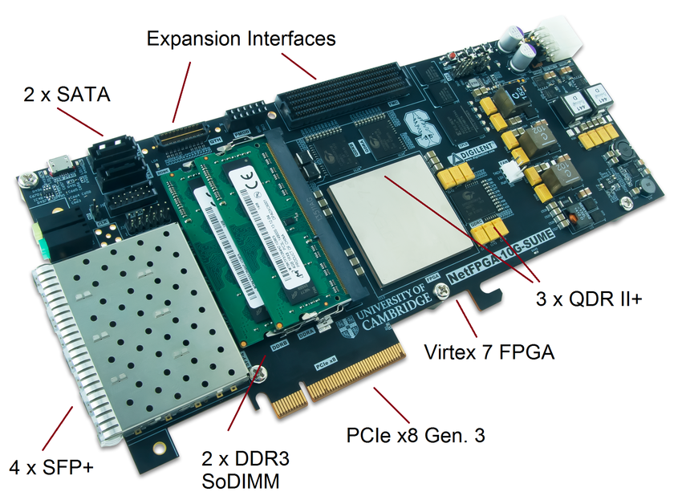

P4→NetFPGA
Prototype and evaluate P4 programs in real hardware!
4x10G network interfaces
Special price for academic users :)
https://github.com/NetFPGA/P4-NetFPGA-public/wiki

Slide 56
Debugging
control MyIngress(...) {
table debug {
key = {
std_meta.egress_spec : exact; }
actions = { }
}
apply {
...
debug.apply();
}
}
Bmv2 maintains logs that keep track of how packets are processed in detail
/tmp/p4s.s1.log
/tmp/p4s.s2.log
/tmp/p4s.s3.log
Can manually add information to the logs by using a dummy debug table that reads headers and metadata of interest
[15:16:48.145] [bmv2] [D] [thread 4090] [96.0] [cxt 0] Looking up key: * std_meta.egress_spec : 2

Slide 57


Questions and Answers
}
Questions for TAs
https://bit.ly/join-p4-lang-slack Join #d2-2018-spring channel
}
Questions for Panel
https://pigeonhole.at Event code: P4D2

Slide 58
Lab 2: P4Runtime
Notes:
In this session, we will look at P4Runtime which provides a target-independent and protocol-independent interface between the control plane and the data plane.

Slide 59
P4 Software Tools
Notes:
Before diving into P4Runtime, let’s briefly review the software tools introduced in the previous session.

Slide 60


Makefile: under the hood
P4Runtime static controller
test.p4
topology.json
P4Runtime client
runtime.json
P4Runtime server
runtime.json
simple_switch_grpc (BMv2)
p4c-bm2-ss
runtime.json
Log
TM
Ingress
Egress
Debug
P4 Debugger
test.json
test.p4info
Parser
Deparser
Packet generator
Port Interface
Packet sniffer
veth0..n
Linux Kernel
Notes:
As a user, you start with a P4 program.
Use the compiler to generate a target-specific configuration blob. - test.json in case of BMv2
The compiler also generate a special file called P4Info that will be needed to install table entries at runtime (we’ll explain this in details later)
Start the switch which at this state doesn’t know how to process packets as we have not loaded the P4 program
Using a P4Runtime static controller, install flow rules that are specified in a runtime.json file
Bring up the network by connecting mininet hosts through linux virtual interfaces
In addition, BMv2 also provides debugging and logging functionality.
Let’s see what happens under the hood

Slide 61
Makefile: under the hood (in pseudocode)
P4C_ARGS = --p4runtime-file $(basename $@).p4info
--p4runtime-format text
RUN_SCRIPT = ../../utils/run_exercise.py
TOPO = topology.json
dirs:
mkdir -p build pcaps logs
build: for each P4 program, generate BMv2 json file
p4c-bm2-ss --p4v 16 $(P4C_ARGS) -o $@ $<
run: build, then [default target]
sudo python $(RUN_SCRIPT) -t $(TOPO)
stop: sudo mn -c
clean: stop, then
rm -f *.pcap
rm -rf build pcaps logs

Slide 62
Step 1: P4 Program compilation [build phase]
test.p4
$ p4c-bm2-ss --p4v 16 \
-o test.json \
--p4runtime-file test.p4info \
--p4runtime-format text \
test.p4
p4c-bm2-ss
test.json
test.p4info
Notes:
Step 1 - The compiler is invoked with various flags to create the JSON config and P4Info file

Slide 63
Step 2: run_exercise.py [run phase]
Create network based on topology.json
Start simple_switch_grpc instance for each switch
Use P4Runtime to push the P4 program (P4Info and BMv2 JSON)
Add the static rules defined in runtime.json
P4Runtime static controller
runtime.json
P4Runtime client (gRPC)
P4Runtime server (gRPC)
P4Runtime server address and port
Path to BMv2 JSON and P4Info to deploy
Table entries
simple_switch_grpc (BMv2)
TM
Log
Ingress
Egress
Debug
Parser
Deparser
Port Interface
veth0..n
Linux Kernel

Slide 64
Step 3: Run the traffic generator and sniffer
In some exercises, this is
send.py and receive.py
In others, we use standard
Linux programs, like ping
In the p4runtime exercise,
we also run our own controller:
mycontroller.py instead of
the static one
P4Runtime static controller
P4Runtime client
P4Runtime server
simple_switch_grpc (BMv2)
TM
Log
Ingress
Egress
Debug
P4 Debugger
Parser
Deparser
Packet generator
Port Interface
Packet sniffer
veth0..n
Linux Kernel

Slide 65
P4Runtime
API overview
Workflow
Exercise - Tunneling
Why P4Runtime?
Notes:
In this session, I will:
Give a quick overview of P4Runtime API
Show the workflow associated with using this API
We will do a exercise that uses P4Runtime to program flow rules
And finally, I will briefly show how this can be integrated with SDN controllers such as ONOS.

Slide 66
Runtime control of P4 data planes
User supplied
Control Plane
P4 Program
P4 Compiler
Add/remove table entries
Extern control
Packet-in/out
CPU port
P4 Architecture
Model
Data Plane
Target-specific configuration binary
Tables
Extern
objects
Load
Focus of this session
Vendor supplied
Notes:
These are the various components involved during the run time
We have some user-specified components in green and Vendor-provided components in orange.
Details on each box
Once you have the control plane and the data plane ready, we would need a mechanism for them to communicate and understand the same protocol.

Slide 67
Existing approaches to runtime control
P4 compiler auto-generated runtime APIs
Program-dependent -- hard to provision new P4 program without restarting the control plane!
BMv2 CLI
Program-independent, but target-specific -- control plane not portable!
OpenFlow
Target-independent, but protocol-dependent -- protocol headers and actions baked in the specification!
OCP Switch Abstraction Interface (SAI)
Target-independent, but protocol-dependent
Notes:
Let’s review some of the existing approaches to achieve this
First, we have the auto-generated APIs by P4 compiler. These are C++ APIs that provide functionality such as add/remove flow rules etc. However, the API is tied to the P4 program. If the program changes, the API needs to change too. And you would need to restart the controller.
Next is BMv2 CLI, which we have been using so far for the exercises. This API is program-independent
Meaning that the API doesn’t change when the P4 program changes
However, this API is tied to a specific target - BMv2 and cannot be ported to other targets.
Next let’s look at OpenFlow
OpenFlow is target-independent --- it doesn’t depend on the underlying target and architecture. You can use the same protocol for a software switch, or a harware switch from multiple vendors
However, the set of protocols that OpenFlow supports is baked-in and it’s not trivial to extend it.
For example, if we look at the basic tunneling example, OpenFlow would not be able to support the new header field.
Similar case with SAI

Slide 68

Why do we need another data plane control API?

Slide 69
Properties of a runtime control API
API | Target-independent | Protocol-independent
P4 compiler auto-generated | ✔ | ✘
BMv2 CLI | ✘ | ✔
OpenFlow | ✔ | ✘
SAI | ✔ | ✘
P4Runtime | ✔ | ✔
Notes:
We identified two kinds of dependencies that prevent these approaches from being usable in a more general way
Target
Protocol
To this end, P4Runtime aims to provide a Target-independent and protocol-independent API to control the dataplane.

Slide 70


What is P4Runtime?
Framework for runtime control of P4 targets
Open-source API + server implementation
https://github.com/p4lang/PI
Initial contribution by Google and Barefoot
Work-in-progress by the p4.org API WG
Draft of version 1.0 available
Protobuf-based API definition
p4runtime.proto
gRPC transport
P4 program-independent
API doesn’t change with the P4 program
Enables field-reconfigurability
Ability to push new P4 program without recompiling the software stack of target switches
Control plane
p4runtime.proto (API)
Program-independent server (e.g. gRPC)
Target driver
P4 target
Notes:
P4Runtime is a framework for runtime control of P4 targets.
This is an open-source project with initial contributions from Barefoot and Google - see link
Explain figure on right
Protobuf allows easy serialization and supports a wide range of programming languages
gRPC as default transport mechanism
It also enables field-reconfigurability
Now, let’s jump in to the details and see how P4Runtime achieves this.

Slide 71
Protocol Buffers Basics
Language for describing data for serialization in a structured way
Common binary wire-format
Language-neutral
Code generators for: Action Script, C, C++, C#, Clojure, Lisp, D, Dart, Erlang, Go, Haskell, Java, Javascript, Lua, Objective C, OCaml, Perl, PHP, Python, Ruby, Rust, Scala, Swift, Visual Basic, ...
Platform-neutral
Extensible and backwards compatible
Strongly typed
syntax = "proto3";
message Person { string name = 1; int32 id = 2; string email = 3; enum PhoneType { MOBILE = 0; HOME = 1; WORK = 2; } message PhoneNumber { string number = 1; PhoneType type = 2; } repeated PhoneNumber phone = 4; }

Slide 72
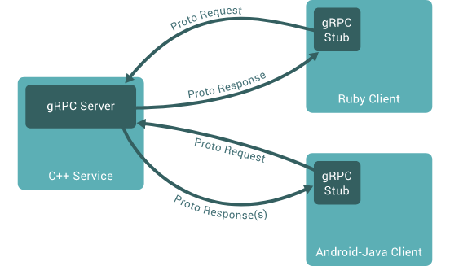
gRPC Basics
Use Protocol Buffers to define service API and messages
Automatically generate native stubs in:
C / C++
C#
Dart
Go
Java
Node.js
PHP
Python
Ruby
Transport over HTTP/2.0 and TLS
Efficient single TCP connection implementation that supports bidirectional streaming

Slide 73
gRPC Service Example
// The greeter service definition. service Greeter { // Sends a greeting rpc SayHello (HelloRequest) returns (HelloReply) {} } // The request message containing the user's name. message HelloRequest { string name = 1; } // The response message containing the greetings message HelloReply { string message = 1; }
More details here: https://grpc.io/docs/guides/

Slide 74
P4Runtime Service
Enables a local or remote entity to load the pipeline/program, send/receive packets, and read and write forwarding table entries, counters, and other chip features.
service P4Runtime {
rpc Write(WriteRequest) returns (WriteResponse) {}
rpc Read(ReadRequest) returns (stream ReadResponse) {}
rpc SetForwardingPipelineConfig(SetForwardingPipelineConfigRequest)
returns (SetForwardingPipelineConfigResponse) {}
rpc GetForwardingPipelineConfig(GetForwardingPipelineConfigRequest)
returns (GetForwardingPipelineConfigResponse) {}
rpc StreamChannel(stream StreamMessageRequest)
returns (stream StreamMessageResponse) {}
}

Slide 75
P4Runtime Service
Protobuf Definition:
https://github.com/p4lang/PI/blob/master/proto/p4/v1/p4runtime.proto
Service Specification:
Working draft of version 1.0 is available now
https://p4.org/p4-spec/docs/P4Runtime-v1.0.0.pdf

Slide 76
P4Runtime Write Request
message WriteRequest {
uint64 device_id = 1;
uint64 role_id = 2;
Uint128 election_id = 3;
repeated Update updates = 4;
}
message Entity {
oneof entity {
ExternEntry extern_entry = 1;
TableEntry table_entry = 2;
ActionProfileMember
action_profile_member = 3;
ActionProfileGroup
action_profile_group = 4;
MeterEntry meter_entry = 5;
DirectMeterEntry direct_meter_entry = 6;
CounterEntry counter_entry = 7;
DirectCounterEntry direct_counter_entry = 8;
PacketReplicationEngineEntry
packet_replication_engine_entry = 9;
ValueSetEntry value_set_entry = 10;
RegisterEntry register_entry = 11;
}
}
message Update {
enum Type {
UNSPECIFIED = 0;
INSERT = 1;
MODIFY = 2;
DELETE = 3;
}
Type type = 1;
Entity entity = 2;
}

Slide 77
P4Runtime Table Entry
p4runtime.proto simplified excerpts:
To add a table entry, the control plane needs to know:
IDs of P4 entities
Tables, field matches, actions, params, etc.
Field matches for the particular table
Match type, bitwidth, etc.
Parameters for the particular action
Other P4 program attributes
message TableEntry { uint32 table_id; repeated FieldMatch match; Action action; int32 priority; ... }
message FieldMatch { uint32 field_id; message Exact { bytes value; } message Ternary { bytes value; bytes mask; } ... oneof field_match_type { Exact exact; Ternary ternary; ... } }
message Action { uint32 action_id; message Param { uint32 param_id; bytes value; } repeated Param params; }
Full protobuf definition: https://github.com/p4lang/PI/blob/master/proto/p4/p4runtime.proto
Notes:
Here I have an excerpt from the protocol definition showing the message format for installing a table entry.
Explain each line in the code.
Now, both the control plane and the dataplane have to agree on this message format. Let’s see how P4Runtime achieves this.

Slide 78
P4Runtime workflow
P4Info
Captures P4 program attributes needed at runtime
IDs for tables, actions, params, etc.
Table structure, action parameters, etc.
Protobuf-based format
Target-independent compiler output
Same P4Info for BMv2, ASIC, etc.
test.p4
p4c-bm2-ss (compiler)
Control plane
test.p4info
p4runtime.proto
test.json
P4Runtime server
BMv2 driver
simple_switch
Full P4Info protobuf specification:
https://github.com/p4lang/PI/blob/master/proto/p4/config/v1/p4info.proto
BMv2
Notes:
The answer is P4Info.
Similar to the target-specific configuration blob, the compiler also generates a file called p4info. This contains the description of all the tables that is needed for runtime control.
This is shared between the control plane and the data plane.
Defines the “contract” between the two planes.
The file format is based on protobuf, and you can see the definition at the link.
One thing to note is that the output is target-independent.

Slide 79
P4Info example
basic_router.p4
basic_router.p4info
...
action ipv4_forward(bit<48> dstAddr,
bit<9> port) {
/* Action implementation */
}
...
table ipv4_lpm {
key = {
hdr.ipv4.dstAddr: lpm;
}
actions = {
ipv4_forward;
...
}
...
}
actions {
id: 16786453
name: "ipv4_forward"
params {
id: 1
name: "dstAddr"
bitwidth: 48
...
id: 2
name: "port"
bitwidth: 9
}
}
...
tables {
id: 33581985
name: "ipv4_lpm"
match_fields {
id: 1
name: "hdr.ipv4.dstAddr"
bitwidth: 32
match_type: LPM
}
action_ref_id: 16786453
}
P4 compiler
Notes:
Let’s look at a concrete example to make this more clear.
Go through each line.

Slide 80
P4Runtime Table Entry Example
basic_router.p4
Protobuf message
action ipv4_forward(bit<48> dstAddr,
bit<9> port) {
/* Action implementation */
} table ipv4_lpm {
key = {
hdr.ipv4.dstAddr: lpm;
}
actions = {
ipv4_forward;
...
}
...
}
table_entry {
table_id: 33581985
match {
field_id: 1
lpm {
value: "\n\000\001\001"
prefix_len: 32
}
}
action {
action_id: 16786453
params {
param_id: 1
value: "\000\000\000\000\000\n"
}
params {
param_id: 2
value: "\000\007"
}
}
}
Control plane generates
Logical view of table entry
hdr.ipv4.dstAddr=10.0.1.1/32 -> ipv4_forward(00:00:00:00:00:10, 7)
Notes:
Now, let’s return to the messaging format specified by P4Runtime and see an example for adding a new table entry.
Protobuf bytes encoding in ASCII format

Slide 81
P4Runtime SetPipelineConfig
message SetForwardingPipelineConfigRequest {
enum Action {
UNSPECIFIED = 0;
VERIFY = 1;
VERIFY_AND_SAVE = 2;
VERIFY_AND_COMMIT = 3;
COMMIT = 4;
RECONCILE_AND_COMMIT = 5;
}
uint64 device_id = 1;
uint64 role_id = 2;
Uint128 election_id = 3;
Action action = 4;
ForwardingPipelineConfig config = 5;
}
test.p4
Pipeline config
p4info
json
Control plane
p4c-bm2-ss (compiler)
SetPipelineConfig()
Pipeline config bits
P4Runtime server
BMv2 driver
BMv2
simple_switch_grpc
message ForwardingPipelineConfig {
config.P4Info p4info = 1;
// Target-specific P4 configuration.
bytes p4_device_config = 2;
}

Slide 82
P4Runtime StreamChannel
message StreamMessageRequest {
oneof update {
MasterArbitrationUpdate
arbitration = 1;
PacketOut packet = 2;
}
}
message StreamMessageResponse {
oneof update {
MasterArbitrationUpdate
arbitration = 1;
PacketIn packet = 2;
}
}
// Packet sent from the controller to the switch.
message PacketOut {
bytes payload = 1;
// This will be based on P4 header annotated as
// @controller_header("packet_out").
// At most one P4 header can have this annotation.
repeated PacketMetadata metadata = 2;
}
// Packet sent from the switch to the controller.
message PacketIn {
bytes payload = 1;
// This will be based on P4 header annotated as
// @controller_header("packet_in").
// At most one P4 header can have this annotation.
repeated PacketMetadata metadata = 2;
}

Slide 83
P4Runtime Common Parameters
device_id
Specifies the specific forwarding chip or software bridge
Set to 0 for single chip platforms
role_id
Corresponds to a role with specific capabilities (i.e. what operations, P4 entities, behaviors, etc. are in the scope of a given role)
Role definition is currently agreed upon between control and data planes offline
Default role_id (0) has full pipeline access
election_id
P4Runtime supports mastership on a per-role basis
Client with the highest election ID is referred to as the "master", while all other clients are referred to as "slaves"
Set to 0 for single instance controllers

Slide 84
Mastership Arbitration
Upon connecting to the device, the client (e.g. controller) needs to open a StreamChannel
The client must advertise its role_id and election_id using a MasterArbitrationUpdate message
If role_id is not set, it implies the default role and will be granted full pipeline access
The election_id is opaque to the server and determined by the control plane (can be omitted for single-instance control plane)
The switch marks the client for each role with the highest election_id as master
Master can:
Perform Write requests
Receive PacketIn messages
Send PacketOut messages

Slide 85



Remote control
table_entry {
table_id: 33581985
match {
field_id: 1
lpm {
value: "\f\000\...
prefix_len: 8
}
}
action {
action_id: 16786453
params {
param_id: 1
value: "\000\0...
}
params {
param_id: 2
value: 7
}
}
}
Target-independent protobuf format
OSPF
BGP
P4-defined custom protocol
etc.
p4info
Remote control plane
p4info
p4info
p4info
P4Runtime control server
P4Runtime control server
P4Runtime control server
Target driver
Target driver
Target driver
Vendor A
Vendor B
Vendor C
Notes:
What’s cool about this approach is that:
Say you have a network with switches from different vendors - which may support different architecture.
However, if all of them are running the same P4 program, the same messages can be used by the controller to program all the devices

Slide 86
Local control
Same target-independent protobuf format
table_entry {
table_id: 33581985
match {
field_id: 1
lpm {
value: "\f\000\...
prefix_len: 8
}
}
action {
action_id: 16786453
params {
param_id: 1
value: "\000\0...
}
params {
param_id: 2
value: 7
}
}
}
OSPF
BGP
P4-defined protocol
etc.
p4info
Local control plane
p4info
P4Runtime control server
Target driver
P4 target
P4Runtime can be used equally well by a remote or local control plane
Notes:
The same runtime API can be used for local control too.

Slide 87
P4Runtime API recap
Things we covered:
P4Runtime definition
P4Info
Table entries
Set pipeline config
Packet-in/out support
Controller replication
Via master-slave arbitration
What we didn’t cover:
How to control other P4 entities
Externs, counters, meters
Batched reads/writes
Switch configuration
Outside the P4Runtime scope
Achieved with other mechanisms
e.g., OpenConfig and gNMI
Notes:
To recap, we have looked at:
How P4Runtime provides a target-independent and protocol-independent interface using P4Info.
An example of how this API can be used to insert a new flow entry
How the program can be updated at runtime.

Slide 88
P4Runtime exercise
Notes:
Let’s go through a quick exercise to see P4Runtime in action.

Slide 89
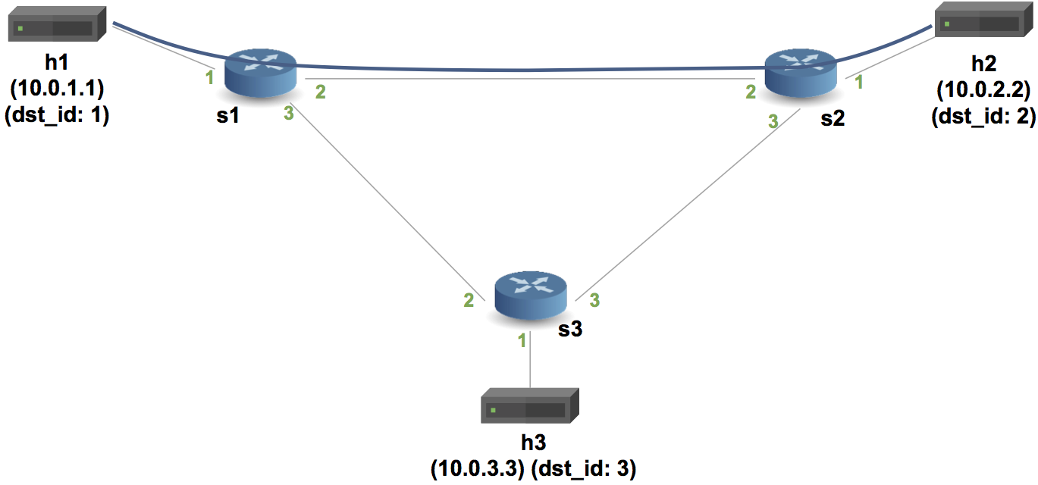
Exercise Overview
Controller’s responsibilities:
Establish a gRPC connection to the switches for the P4Runtime service
Push the P4 program to each switch
Write the tunnel forwarding rules:
myTunnel_ingress rule to encapsulate packets on the ingress switch
myTunnel_forward rule to forward packets on the ingress switch
myTunnel_egress rule to decapsulate and forward packets on the egress switch
Read the tunnel ingress and egress counters every 2 seconds
mycontroller.py
Notes:
The main goal of this exercise to write a remote controller to manage the dataplane…
Explain controller, topology and P4 program.
Added two actions and counters.

Slide 90
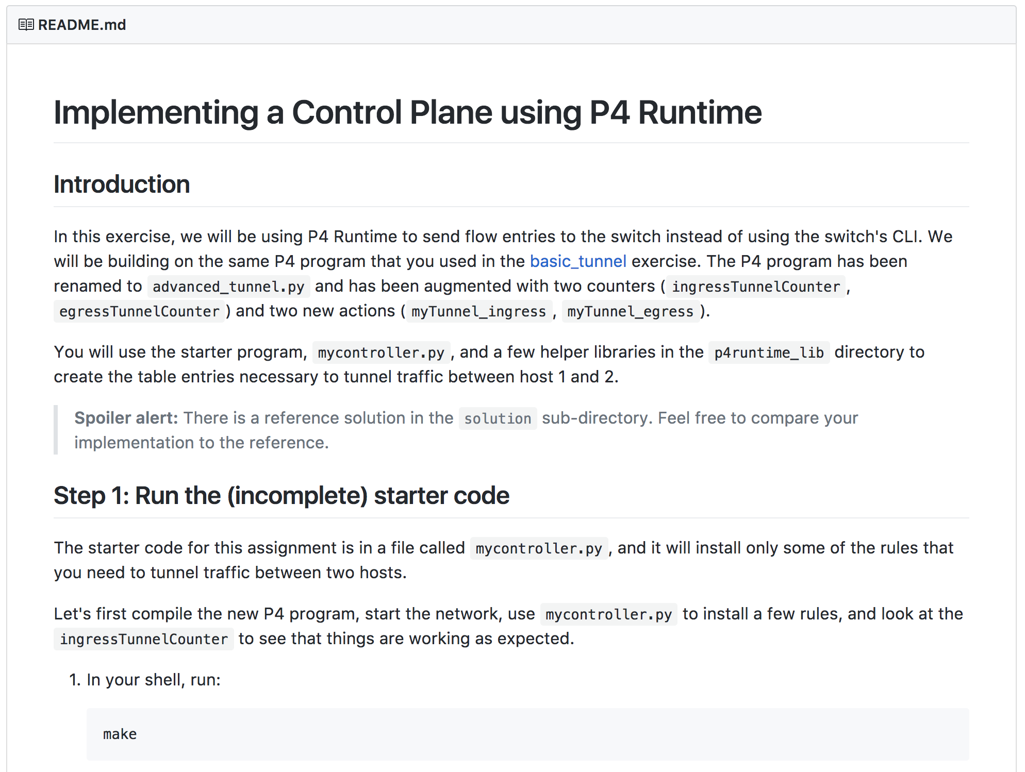
Getting started
The source code has already been downloaded on your VM:
~/tutorials/exercises/p4runtime
You should start by reading the README.md
In this exercise, you will need to complete the
implementation of writeTunnelRules
in mycontroller.py
You will need two Terminal windows: one for
your dataplane network (Mininet) that you will
start using make, and the other is for your
controller program.
To find the source code:
https://github.com/p4lang/tutorials/

Slide 91
P4Runtime in the wild
Notes:
Let’s go through a quick exercise to see P4Runtime in action.

Slide 92




P4Runtime-enabled Open Source SDN Stack
Inventory
Global Orchestrator
OSS / BSS
Control and Management Plane
dhcp
SR
SDN Control Services
Configuration Services
Monitoring & Telemetry Services
Admin & Orchestration Services
P4Runtime
OpenConfig
& gNMI
gNOI
spine.p4
spine.p4
Stratum
Stratum
leaf.p4
leaf.p4
leaf.p4
Stratum
Stratum
Stratum

Slide 93
Some Pointers
https://stratumproject.org/
https://onosproject.org/
https://wiki.onosproject.org/display/ONOS/P4+brigade

Slide 94
Lab 3: Monitoring & Debugging

Slide 95
Monitoring & Debugging
Congestion!
Fine …
h1 (10.0.1.1)
h2 (10.0.2.2)
h11 (10.0.1.11)
h22 (10.0.2.22)
s1
s2
Hosts can infer congestion:
RTT
Packet drops
Dup Acks
Switches can
help!
s3
h3 (10.0.3.3)

Slide 96

Monitoring & Debugging
s1

Slide 97
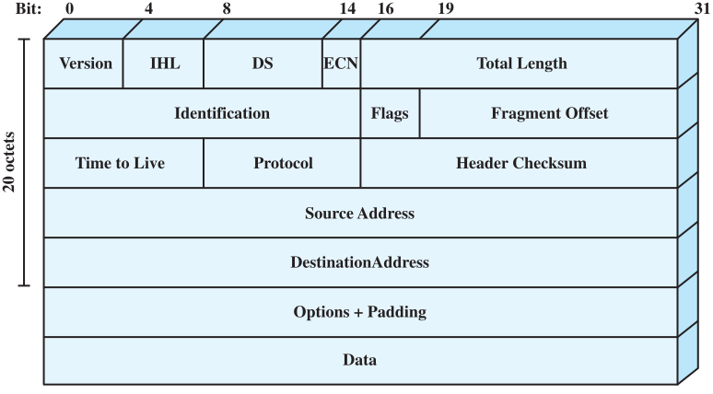
Explicit Congestion Notification
TOS

Slide 98
Explicit Congestion Notification
Explicit Congestion Notification
00: Non ECN-Capable Transport, Non-ECT
10: ECN Capable Transport, ECT(0)
01: ECN Capable Transport, ECT(1)
11: Congestion Encountered, CE
For packets originating from ECT, ECN-capable switches set the CE bit upon congestion
E.g., observed queue depth > threshold

Slide 99
Explicit Congestion Notification in P4
The standard data for the V1Model includes the queue depth: bit<19> standard_metadata.enq_qdepth
Measured here
Available here
Traffic
Manager
Ingress
Egress

Slide 100
Coding Break

Slide 101
Multi-Route Inspection
Switch ID, queue depth, … (anything)
h2 (10.0.2.2)
h1 (10.0.1.1)
pkt
s1
s2
h22 (10.0.2.22)
h11 (10.0.1.11)
The most verbose ECN
Packets carry their own logs!
s3
h3 (10.0.3.3)

Slide 102
Multi-Route Inspect: Packet Format
header mri_t {
bit<16> count;
}
header switch_t {
switchID_t swid;
qdepth_t qdepth;
}
struct headers {
ethernet_t ethernet;
ipv4_t ipv4;
ipv4_option_t ipv4_option;
mri_t mri;
switch_t[MAX_HOPS] swtraces;
}
Header validity opertions:
hdr.setValid(): add_header
hdr.setInvalid(): remove_header
hdr.isValid():test validity
Header Stacks
hdr[CNT] stk;
Header Stacks in Parsers
stk.next
stk.last
stk.lastIndex
Header Stacks in Controls
stk[i]
stk.size
stk.push_front(int count)
stk.pop_front(int count)

Slide 103
Header verification
/* Standard errors, defined in core.p4 */
error { NoError, // no error PacketTooShort, // not enough bits in packet for extract NoMatch, // match expression has no matches StackOutOfBounds, // reference to invalid element of a header stack OverwritingHeader, // one header is extracted twice HeaderTooShort, // extracting too many bits in a varbit field ParserTimeout // parser execution time limit exceeded }
/* Additional error added by the programmer */
error { IPv4BadHeader }
...
state parse_ipv4 {
packet.extract(hdr.ipv4);
verify(hdr.ipv4.version == 4, error.IPv4BadHeader);
transition accept;
}

Slide 104
Coding Break

Slide 105
Questions and Answers
}
Questions for TAs
https://bit.ly/join-p4-lang-slack Join #d2-2018-spring channel
}
Questions for Panel
https://pigeonhole.at Event code: P4D2

Slide 106
Lab 4: Advanced Behavior

Slide 107
Source Routing
2,3,2,2,1, {payload}
h1 (10.0.1.1)
2
2
1
h2 (10.0.2.2)
1
s1
3
3
s2
2
3
1
s3
h3 (10.0.3.3)

Slide 108
Source Routing: Packet Format
#define MAX_HOPS 9
const bit<16> TYPE_IPV4 = 0x800;
const bit<16> TYPE_SRCROUTING = 0x1234;
header srcRoute_t {
bit<1> bos;
bit<15> port;
}
struct headers {
ethernet_t ethernet;
srcRoute_t[MAX_HOPS] srcRoutes;
ipv4_t ipv4;
}
Parse source routes only if etherType is 0x1234
The special value bos == 1 indicates the “bottom of stack”
Forward packets using source routes, and also decrement IPv4 TTL
Drop the packet if source routes are not valid
Hint: Use the next, pop_front primitives packet.extract(hdr.srcRoutes.next) hdr.srcRoutes.pop_front(1)

Slide 109
Coding Break

Slide 110
Calculator
2 + 4 = ?
h1 (10.0.1.1)
s1
2 + 4 = 6

Slide 111
Calculator: Packet Format
0 1 2 3
+----------------+----------------+----------------+---------------+
| P | 4 | Version | Op |
+----------------+----------------+----------------+---------------+
| Operand A |
+----------------+----------------+----------------+---------------+
| Operand B |
+----------------+----------------+----------------+---------------+
| Result |
+----------------+----------------+----------------+---------------+

Slide 112
Table Initializers
table tbl {
key = { hdr.h.f : exact }
actions = { a1; a2; a3 }
entries = {
{ 0x01 } : a1(1);
{ 0x02 } : a1(2);
{ _ } : NoAction();
}
}
Can initialize tables with constant entries
Must fully specify the value of all action data, including values that are normally supplied by the control-plane
Hint: for the calculator, use a table that matches on the op-code

Slide 113
Coding Break

Slide 114
Simple Load Balancing
h1 → 10.0.0.1
h1 (10.0.1.1)
h2 (10.0.2.2)
s1
s2
Virtual IP (10.0.0.1)
shared by h2 and h3
s3
h3 (10.0.3.3)

Slide 115
Hashing (V1Model)
enum HashAlgorithm {
csum16,
xor16,
crc32,
crc32_custom,
crc16,
crc16_custom,
random,
identity
}
extern void hash<O, T, D, M>(
out O result,
in HashAlgorithm algo,
in T base,
in D data,
in M max);
Computes the hash of data (using algo) modulo max and adds it to base
Uses type variables (like C++ templates / Java Generics) to allow hashing primitive to be used with many different types.

Slide 116
Wrapping up & Next Steps

Slide 117
Why P4₁₆?
Clearly defined semantics
You can describe what your data plane program is doing
Expressive
Supports a wide range of architectures through standard methodology
High-level, Target-independent
Uses conventional constructs
Compiler manages the resources and deals with the hardware
Type-safe
Enforces good software design practices and eliminates “stupid” bugs
Agility
High-speed networking devices become as flexible as any software
Insight
Freely mixing packet headers and intermediate results

Slide 118
Things we covered
The P4 ”world view”
Protocol-Independent Packet Processing
Language/Architecture Separation
If you can interface with it, it can be used
Key data types
Constructs for packet parsing
State machine-style programming
Constructs for packet processing
Actions, tables and controls
Packet deparsing
Architectures & Programs

Slide 119
Things we didn’t cover
Mechanisms for modularity
Instantiating and invoking parsers or controls
Details of variable-length field processing
Parsing and deparsing of options and TLVs
Architecture definition constructs
How these “templated” definitions are created
Advanced features
How to do learning, multicast, cloning, resubmitting
Header unions
Other architectures
Control plane interface

Slide 120

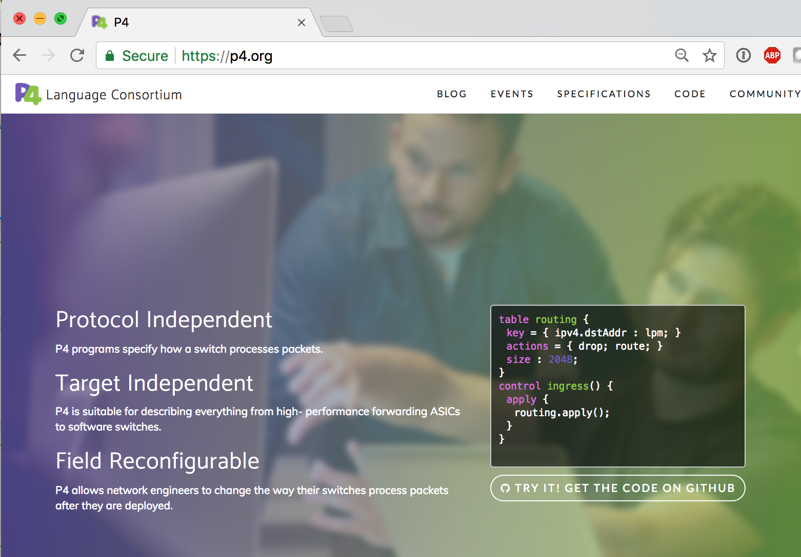
The P4 Language Consortium
Consortium of academic and industry members
Open source, evolving, domain-specific language
Permissive Apache license, code on GitHub today
Membership is free: contributions are welcome
Independent, set up as a California nonprofit

